Slide 1

Unit 10

Slide 2
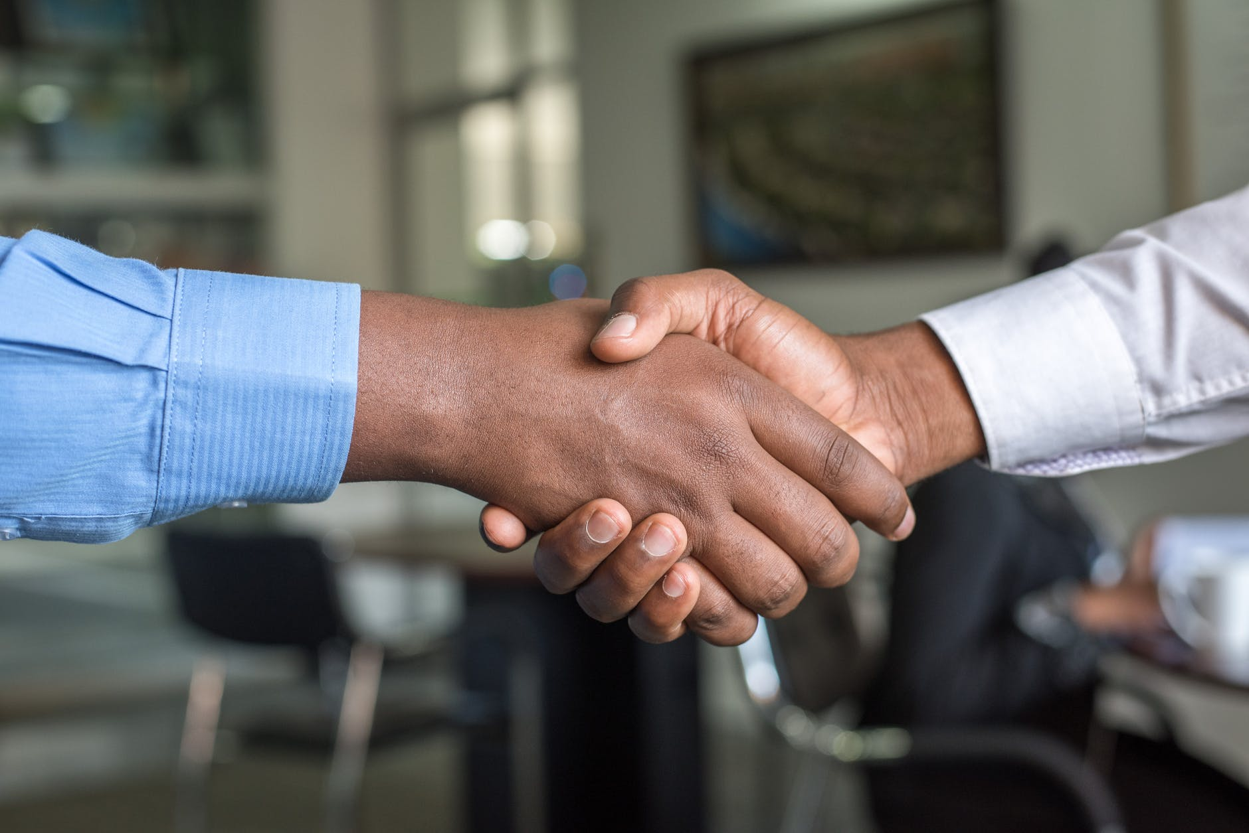
Unit 10
You're supposed to shake hands.

Slide 3
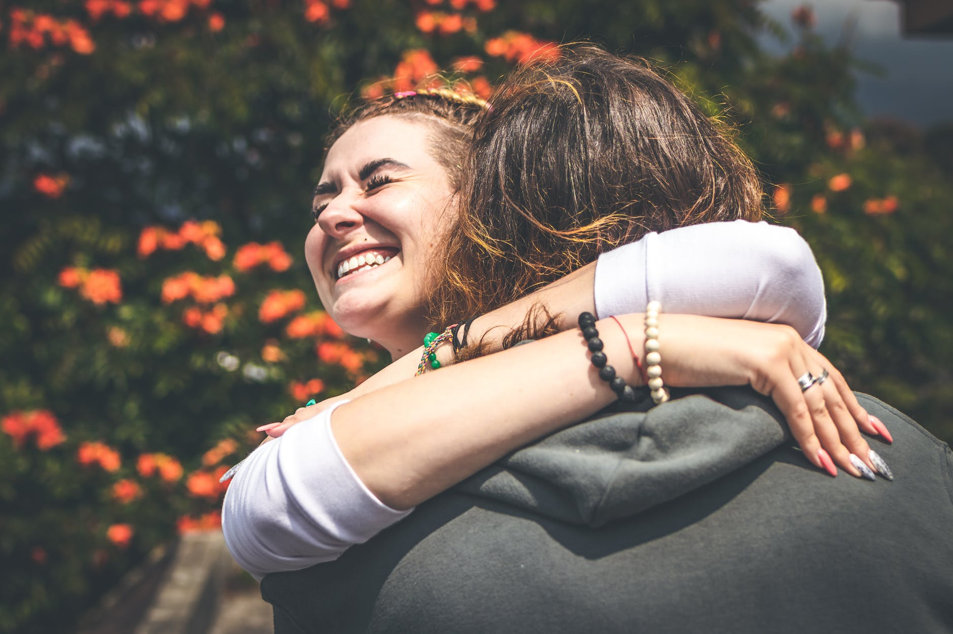


Slide 4



To learn to use:
be supposed + to do
be expected + to do
It is + adj. + to do

Slide 5


Complete the sentences.
1. Walking on the beach makes you feel
________ (放松的).
2. Beijing is the ________ (首都) of China.
3. We usually have lunch at ______ (中午).
4. If you _____ _____ __ _____ (不努力) to
study, you won’t pass the English exam.
relaxed
capital
noon
don’t make an effort

Slide 6
5. You should be easy on these students.
_____ ___ (毕竟), they are kids.
6. I _______ (重视) my friendship with my classmates.
7. Just remember–you can’t ___ ____ (发火) at what they tell you.
After all
valued
get mad

Slide 7


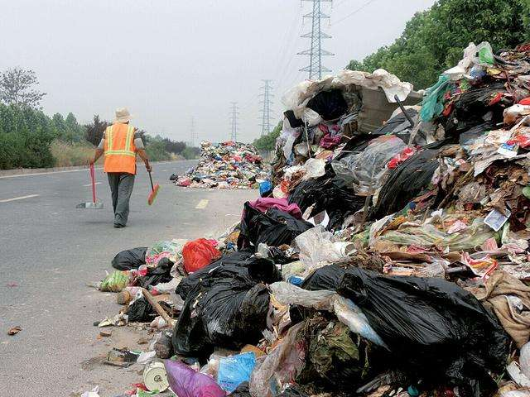
What are you supposed to do when you…
see rubbish everywhere?
We’re supposed to…

Slide 8
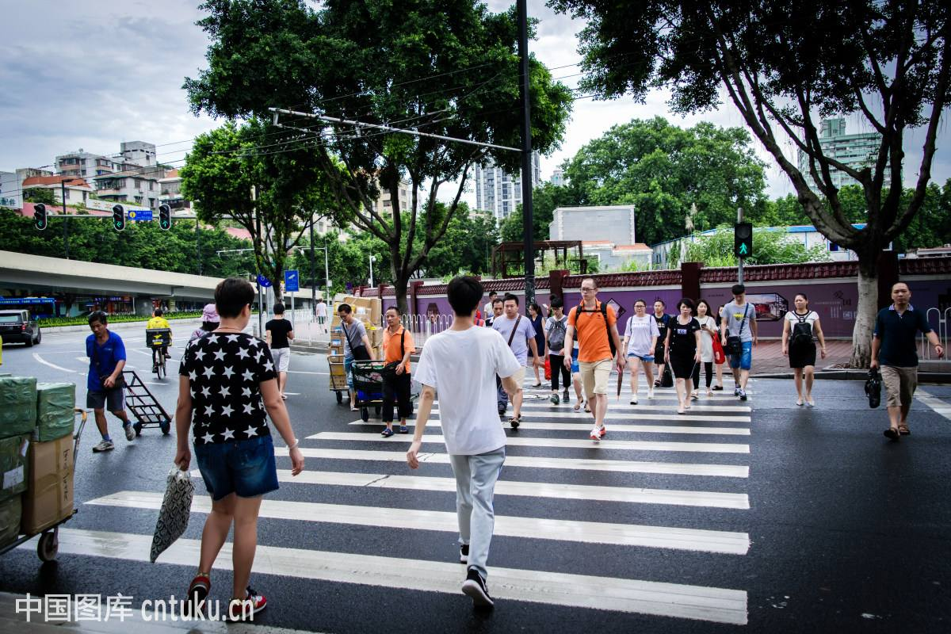
go across the road?
We’re supposed to…

Slide 9
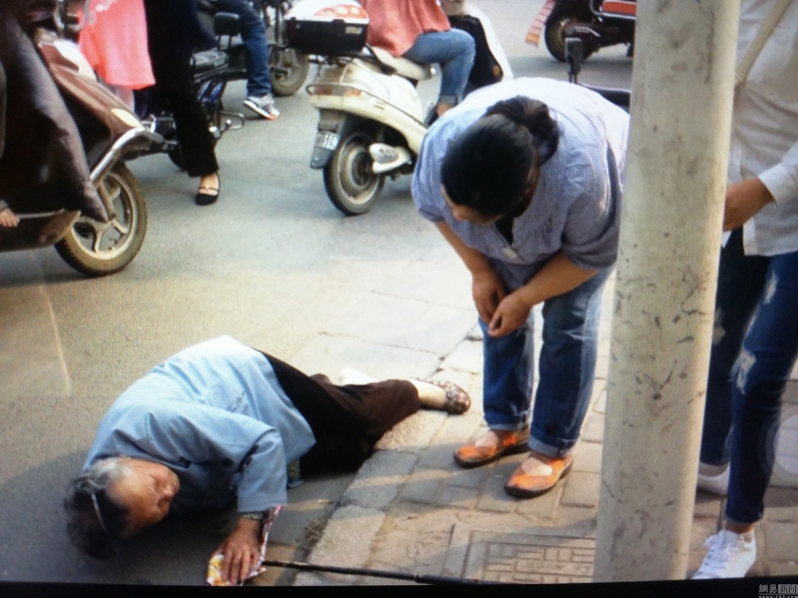
see an old man fall down?
We’re supposed to…

Slide 10


根据课本内容完成句子。
1. —你第一次遇到某一个人应当做什么？
—你应该握手。
—你不应该亲吻。
—_____ _____ you ________ _____ _____ when you meet someone for the first time?
—You ___ ________ ____ ______ ______.
—_____ _____ _______ ____ _____.
What are
supposed to do
are supposed to shake hands
You’re not supposed to kiss

Slide 11
2. —你应该什么时候到？
—我应该7点钟到。
—When were you ________ ____ ______?
—I ____ ________ _____ ______ at 7:00.
supposed to arrive
was supposed to arrive
3. —我应该穿牛仔裤吗？
—不应该, 希望你穿西服打领带。
—_____ I ________ _____ wear jeans?
—No, you _____ ________ _____ wear
a suit and tie.
Am
supposed to
are expected to

Slide 12
4. —让别人一直等待不礼貌吗？
—对, 让别人一直等很不礼貌。
—____ ____ ________ to keep others
waiting?
—Yes, it’s very impolite to keep others
waiting.
5. —准时很重要吗？
—是的, 准时很重要。
—Is ____ _________ ____ ____ on time?
—Yes, it’s important to be on time.
Is it impolite
it important to be

Slide 13


Slide 14

1. be supposed to
1) 按规则规律、义务或约定“应当；理应”去做某事，to为动词不定式符号，+动词原形。
e.g. 你应该明天归还自行车。
You’re supposed to return the bike
tomorrow.
2) be supposed to语意相当于should。
e.g. 你应当更努力地学习。
You’re supposed to study harder.
=You should study harder.

Slide 15
3) 否定式be not supposed to，一般疑问句把be提至主语前。
e.g. You are not supposed to talk loudly in
the hospital.
Am I supposed to get up at 7 o’clock?
4) was / were supposed to本应该。把本应该发生的事与实际发生的事进行对照。
e.g. They were supposed to arrive at nine,
but they were late.

Slide 16
2. be expected to do sth.
被期许(预期)会做某事, 被要求做某事，希望做某事, 表示可能性。
e.g. 希望她能在晚餐前到达。
She was expected to arrive before
dinner.
be supposed to do相对于be expected to
do主观性更强。

Slide 17
【语境应用】完成句子。
1) 我们应该多读书。
We ______________________________ more books.
2) 你不应该把你的自行车放在这里。
You _____________________________
_____ your bike here.
are supposed to read/ should read
aren’t supposed to put/ shouldn’t
put

Slide 18
3) 我本应该今天上午寄信的，但我忘了。
I ___________________ the letter this morning, but I forgot it.
4) 杰克被要求每天早上练习英语。
Jack ____________________ English every morning.
was supposed to post
is expected to practice

Slide 19
Look at these sentences.
形式主语
真正主语
It’s important to be on time.
It’s very impolite to keep others waiting.
It’s normal to cry when we feel sad.
It’s+ adj. + to do sth.
不定式做主语时，常用it来代替不定式结构。it为形式主语，不定式作为真正主语被后置。

Slide 20
【语境应用】翻译句子。
1) 读书是有用的。
2) 每天跑步是健康的。
3) 迟到是糟糕的。
It is useful to read books.
It is healthy to run every day.
It is bad to be late for school.

Slide 21

for sb.的句型常用于表示事物的特征
It is difficult for him to finish the task within two hours.
It is
adj.
for sb.
to do
It is kind of you to help me.
It is
adj.
of sb.
to do
of sb.的句型常用表示人物的性格，品德

Slide 22
Fill in the blanks with of or for.
of
1. It was stupid ____ me to talk in that way to my mother.
2. It is very important ___ us to study
English.
3. It was impossible ____ the little boy to
carry such a heavy box.
4. It is smart ___ them to make good use of the Internet.
for
for
of

Slide 23


Complete the sentences with the phrases in the box.
4a
be supposed to
be expected to
be important to

Slide 24
1. When you go aboard, it _____________ bring your passport.
2. After class, students ____________________________ clean the chalk off the blackboard.
3. If you visit the northern coast of Norway
during the winter season, it _____________
pack warm clothes.
is important to
are supposed to/ are expected to
is important to

Slide 25
4. If there are people in the meeting room,
you ____________________________
knock before entering.
5. In many eastern European countries, you
____________________________
take off your gloves before shaking hands.
are expected to/ are supposed to
are supposed to/ are expected to

Slide 26

take off
脱下(衣服)，与put on意思相反。
e.g. 房间里很热。请脱掉你的外套。
It’s hot in the room. Please take off your
coat.
(飞机等)起飞，与land意思相反。
e.g. 飞机将在一小时后起飞。
The plane will take off in an hour.

Slide 27
【语境应用】单项选择。
My elder brother _______ my wet sports
shoes and made me sit by the fire.
A. took off B. kicked off
C. carried out D. put out
2) The boy likes planes very much and he
often goes to see planes land and _______.
A. take care of B. take off
C. take after D. take down
A
B

Slide 28
3) On the morning of the Spring Festival,
children can’t wait to _______ their new
clothes.
A. put on
B. put up
C. put away
A

Slide 29
Fill in the blanks with the correct forms of the words in brackets.
4b
Each country has different rules about social situations. A traveler ___________________ (not expect; know) all of these, but it is helpful _______ (learn) as many of these customs as possible.
isn’t expected to know
to learn

Slide 30
One of the best ways to be accepted in a foreign country is to try _____________ (understand) how people think. Learning what you ________________ (suppose; do) and _________________ (not suppose; do) in social situations may be difficult, but it is worth the trouble if you want to understand another culture.
to understand
are supposed to do
not supposed to do

Slide 31
worth adj.
值（多少钱）; 相当于……的价值
值得。后接名词(短语)、代词或动词-ing形式，动词-ing形式是主动形式表被动。worth常用well修饰，很值得。
e.g. This old computer is worth 300 dollars.
Is it worth all the trouble?
The new car cost a lot of money, but it’s
certainly worth it.
The book is well worth reading.

Slide 32
【语境应用】根据所给提示完成对话。
A: Linda, what are you going to do this weekend?
B: I have no idea. Can you give me some advice?
A: OK. You can visit the new museum in our city. It’s (1)_____________ (值得参观).
B: But it’s too far from my home.
A: Then how about reading one of the four famous novels A Dream of Red Mansions (《红楼梦》)?
worth visiting

Slide 33
well worth considering about
B: This idea is (2)_________________________ (很值得考虑). I will buy the book.
A: Well, you can buy one online and it is only (3)___________________(大约值二百元).
B: Oh, money is not a problem. The most important thing is that the book is really (4)_________________(值得阅读).
worth about 200 yuan
worth reading

Slide 34
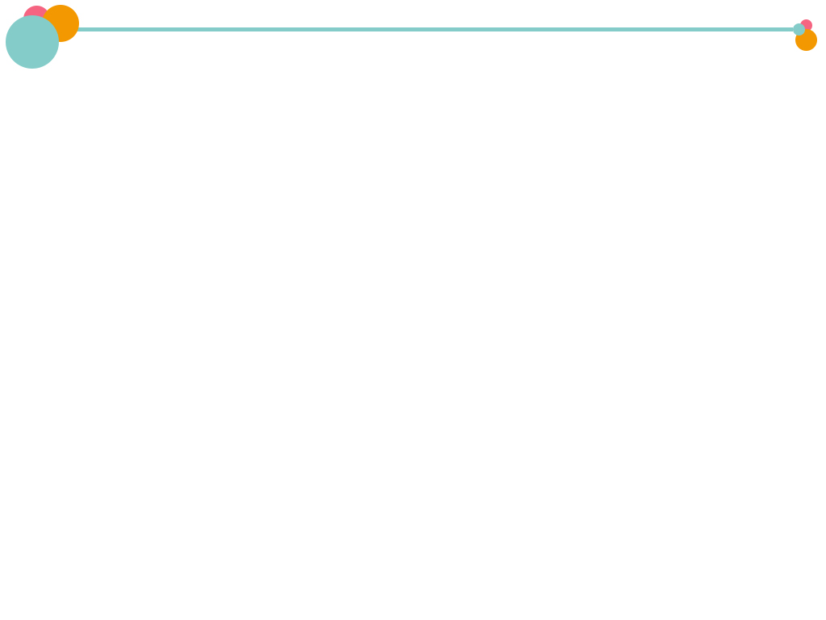

4c
Make a list of advice for someone
coming to your country as an
exchange student for the first time.
Work with your group to give advice
about:

Slide 35
time | what to do for someone’s birthday
meeting people | visiting someone’s home
table manners | giving gifts
always on time or a little earlier
giving birthday gifts
say, “Ni Hao, …”
with a smile
call first, and knock at the door
older people eating first
festival gifts

Slide 36


1. 亲吻某人脸颊
2. 慢慢享受我们的时光
3. 珍惜时间
4. 在我们的日常生活中
5. 顺便访问
6. 计划做某事
7. 守时
8. 毕竟；终归
kiss sb. on both sides of
sb.’s face
enjoy our time slowly
value time
in our everyday lives
drop by
make plans to do sth.
be on time
after all

Slide 37
9. 生气；气愤
10. 努力做某事
11. 避免拥堵的交通
12. 这没什么大不了的
get mad
make an effort to do sth.
avoid heavy traffic
It’s no big deal.

Slide 38

Ⅰ. 根据语境及提示，补全所缺单词。
1. Of the four s , spring is my favorite.
2. One of the things that Jerry v is the love of friends.
3. —I k on the door but nobody answered.
—Oh, we were all out.
4. Don’t forget to take your p with you when you go abroad.
seasons
values
knocked
passport

Slide 39
5. As the c of China, Beijing is a modern city with a long history.
6. Paula likes traveling. It is very interesting and it makes her feel happy and r .
capital
relaxed

Slide 40
Ⅱ. 根据句意及提示，完成下列句子。
1. They often _________ _________(顺便拜访) their friends’ homes.
2. Alfred is getting hot, so he is going to _________ _________(脱下) his coat.
3. Although Emily did something wrong, _________ _________ _________ _________ _________(这没什么大不了的).
4. Students should _________ _________ _________ _________(把粉笔从……上擦掉) the blackboard after class.
drop by
take off
it was no big
deal
clean the
chalk off

Slide 41
got mad
5. Mr. Griffin _________ _________(大动肝火) because his daughter told a lie yesterday.
6. Brian has lots of work to finish before Friday, so he doesn’t even have a rest _________ _________(在中午).
at noon

Slide 42
Ⅲ. 根据意思及提示语，翻译下列句子。
1. 遵守交通规则是很重要的。 (it)
2. 艾伦(Alan)计划熬夜吗？ (plan)
3. 你为什么如此担忧？毕竟不是你的问题。 (after all)
It’s very important to follow the traffic rules.
Does Alan make plans to stay up late? /
Does Alan plan to stay up late?
Why are you so worried? It isn’t your problem after all.

Slide 43
4. 老师应该鼓励学生们努力学习。(make an effort)
5. 布莱克(Black)先生认为中国民族音乐很值得一听。(worth)
6. 暑假里妈妈让我一直学数学，因为我数学考试不及格。(keep)
Teachers should encourage students to make an effort to study.
Mr. Black thinks that Chinese folk music is well worth listening to.
Mom kept me studying math during the summer holidays, for I failed my math exam.

Slide 44


1. Make 5 sentences with be supposed to do/be expected to…
2. 根据小组对4c讨论的结果，写一篇短文。

Slide 45
